Slide 1
Object Oriented Programming Lab CSE 1206
Lab 6

Slide 2
Method Overriding
If subclass (child class) has the same method as declared in the parent class, it is known as method overriding.
Rules for Java Method Overriding
1. method must have same name as in the parent class
2. method must have same parameter as in the parent class.
3. must be in a relationship (inheritance).

Slide 3
Real example of Java Method Overriding
Consider the follwing scenario:
Bank is a class that provides functionality to get rate of interest. But, rate of interest varies according to banks. For example,
BRAC, DBBL and HSBC banks could provide 8%, 7% and 9% rate of interest respectively.

Slide 4
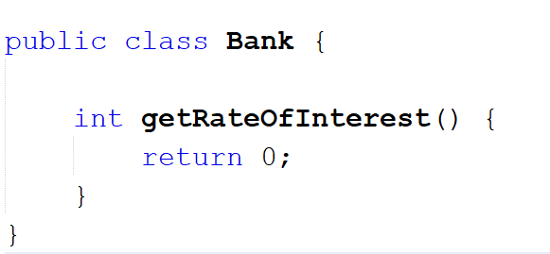
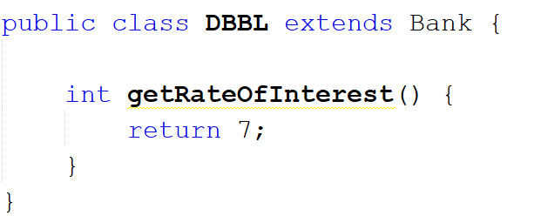
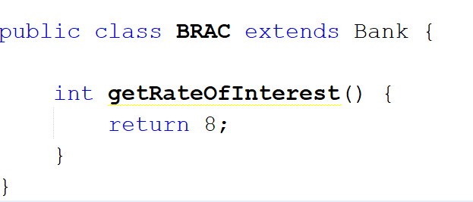
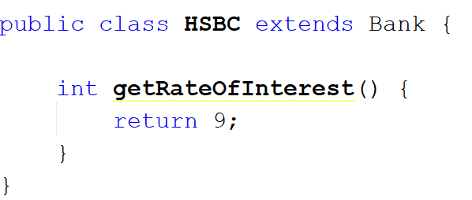

Slide 5
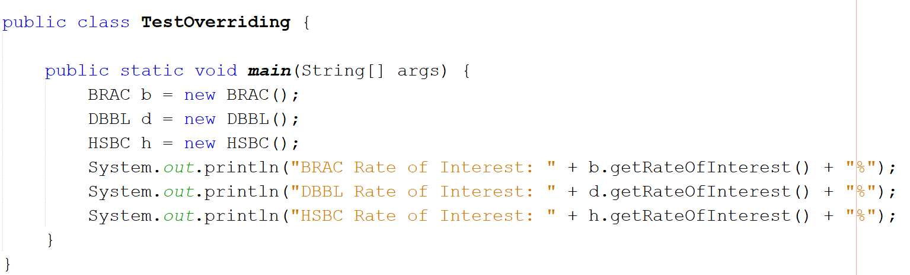
Test the method Overriding

Slide 6
Exercise: Create a class 'Degree' having a method 'getDegree' that prints "I got a degree". It has two subclasses namely 'Undergraduate' and 'Postgraduate' each having a method with the same name that prints "I am an Undergraduate" and "I am a Postgraduate" respectively. Call the method by creating an object of each of the three classes.

Slide 7
Abstract Class

Slide 8
A class which contains the abstract keyword in its declaration is known as abstract class.
Abstract classes may or may not contain abstract methods, i.e., methods without body ( public void get(); )
But, if a class has at least one abstract method, then the class must be declared abstract.
If a class is declared abstract, it cannot be instantiated.
To use an abstract class, you have to inherit it from another class, provide implementations to the abstract methods in it.
If you inherit an abstract class, you have to provide implementations to all the abstract methods in it.

Slide 9
Create a Project named AbstractDemo. Then create a new class named Employee.

Slide 10
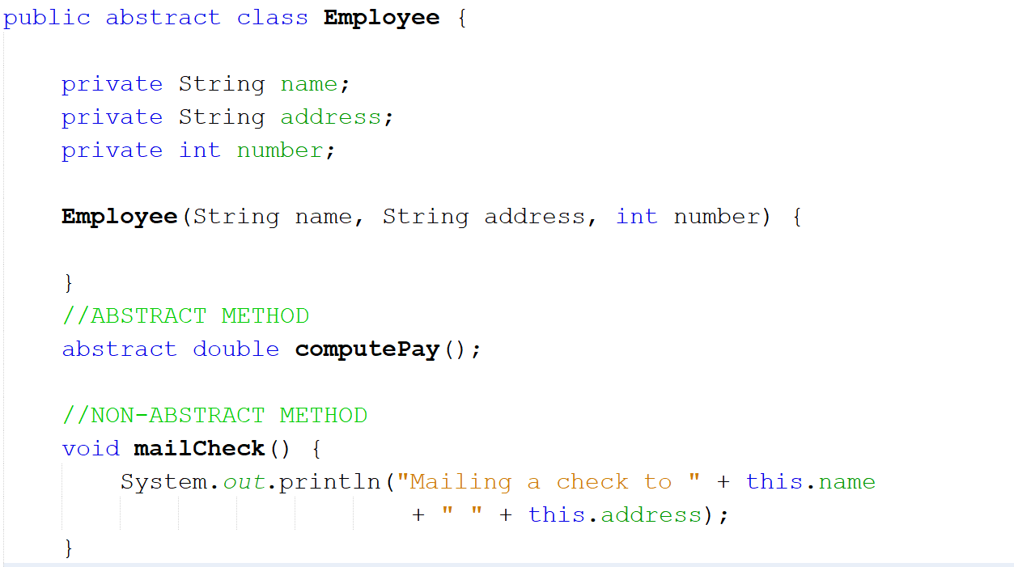
Abstract Method has no body

Slide 11
Create getter and setter methods for the private variable. Then create another class named Salary that extends Employee class

Slide 12
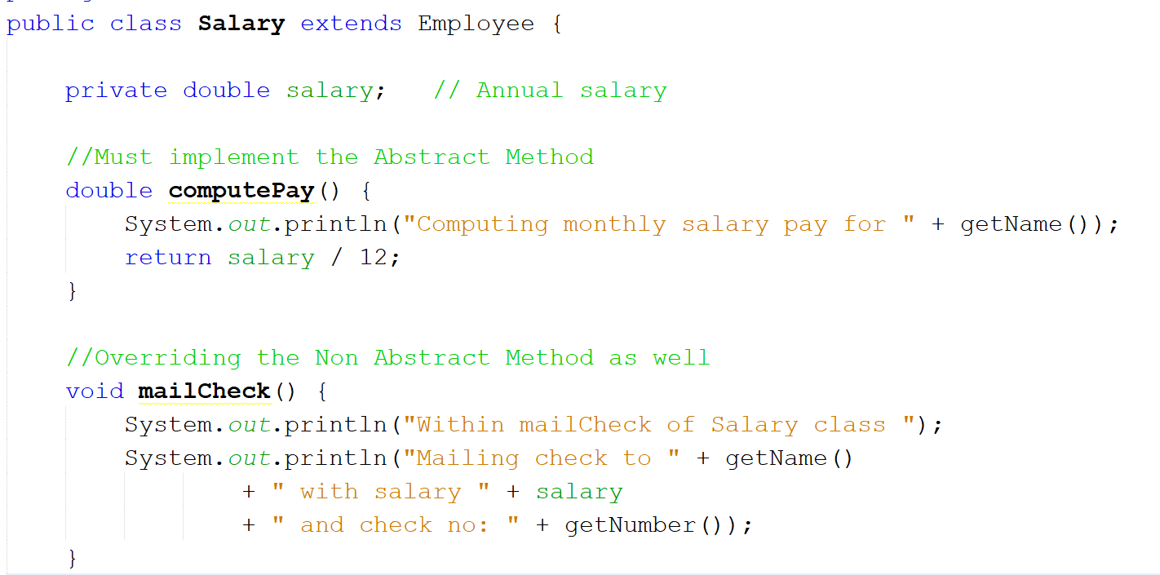

Slide 13
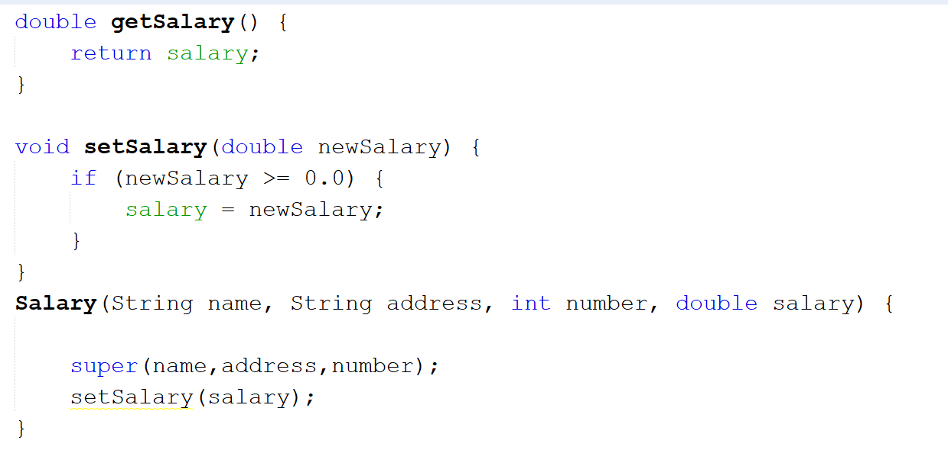

Slide 14
Testing the Methods in AbstractDemo class

Slide 15
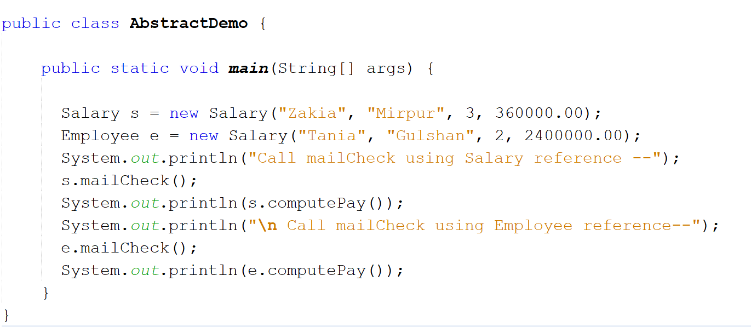

Slide 16
Preventing Inheritance Using Final keyword

Slide 17
Final keyword is used to prevent a class from being inherited.
Syntax
final class A{
}
class B extends A { // Error
}

Slide 18
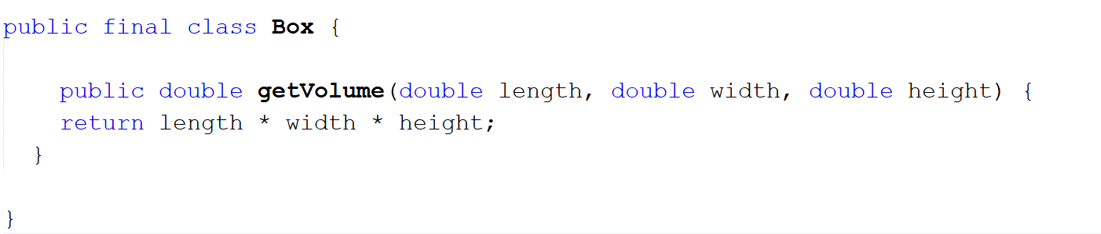

Slide 19
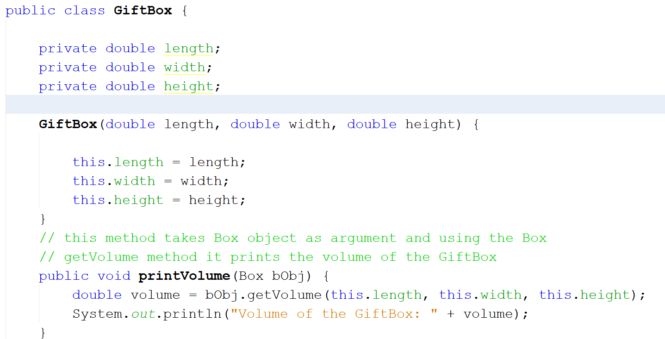

Slide 20
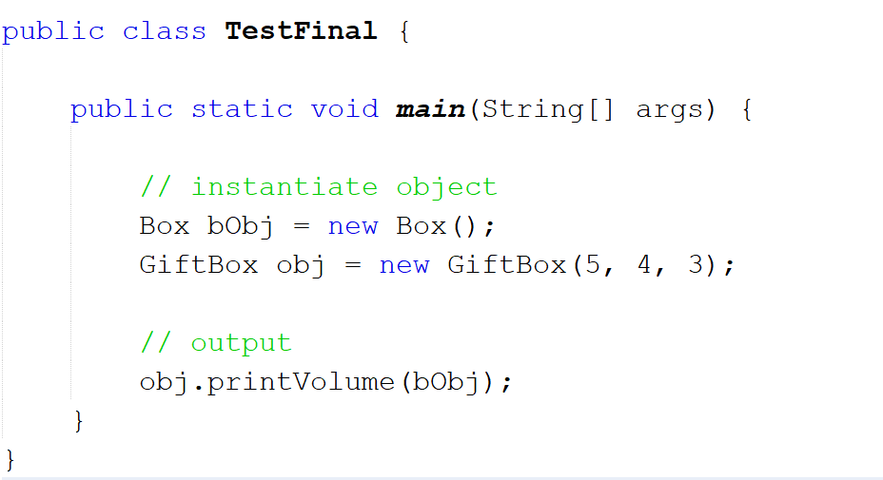

Slide 21
Other Uses of Final
Final variable -> used to create constant variables
Final methods -> prevents method overriding

Slide 22
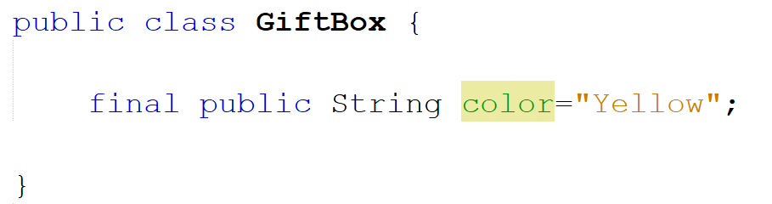
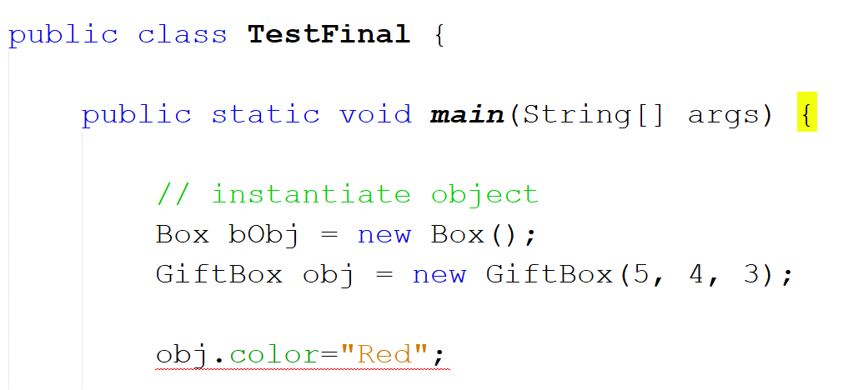
Final
Variable

Slide 23
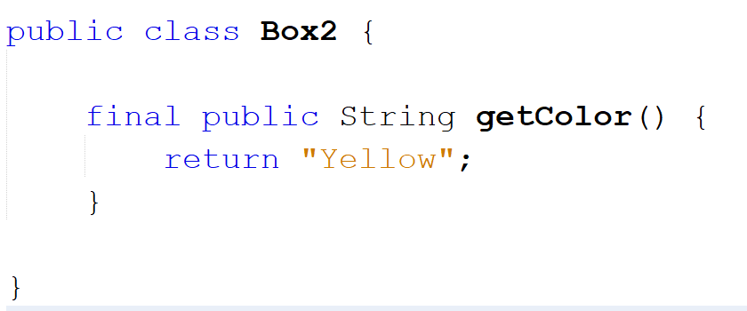
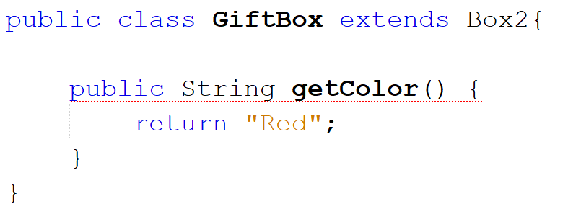
Final
Method

